Slide 1
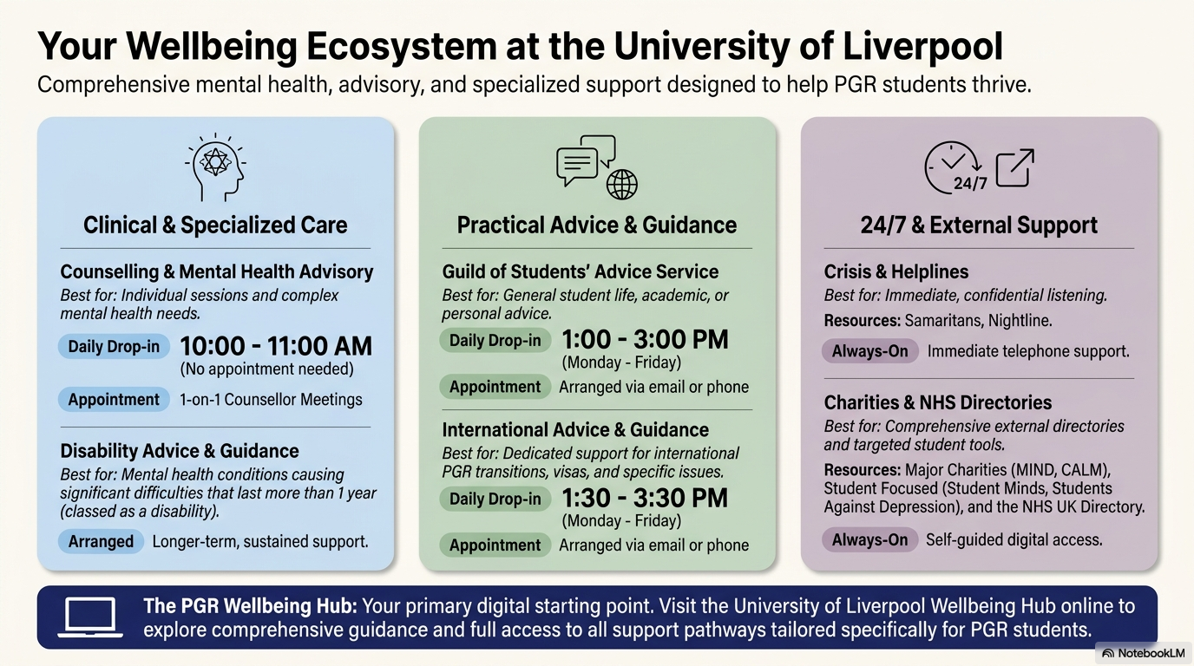
Please visit this for more links: https://nwssdtp.ac.uk/university-of-liverpool-wellbeing-support/

