Slide 1
Crowd-Sourced Heritage
Dr Ben Anderson

Slide 2
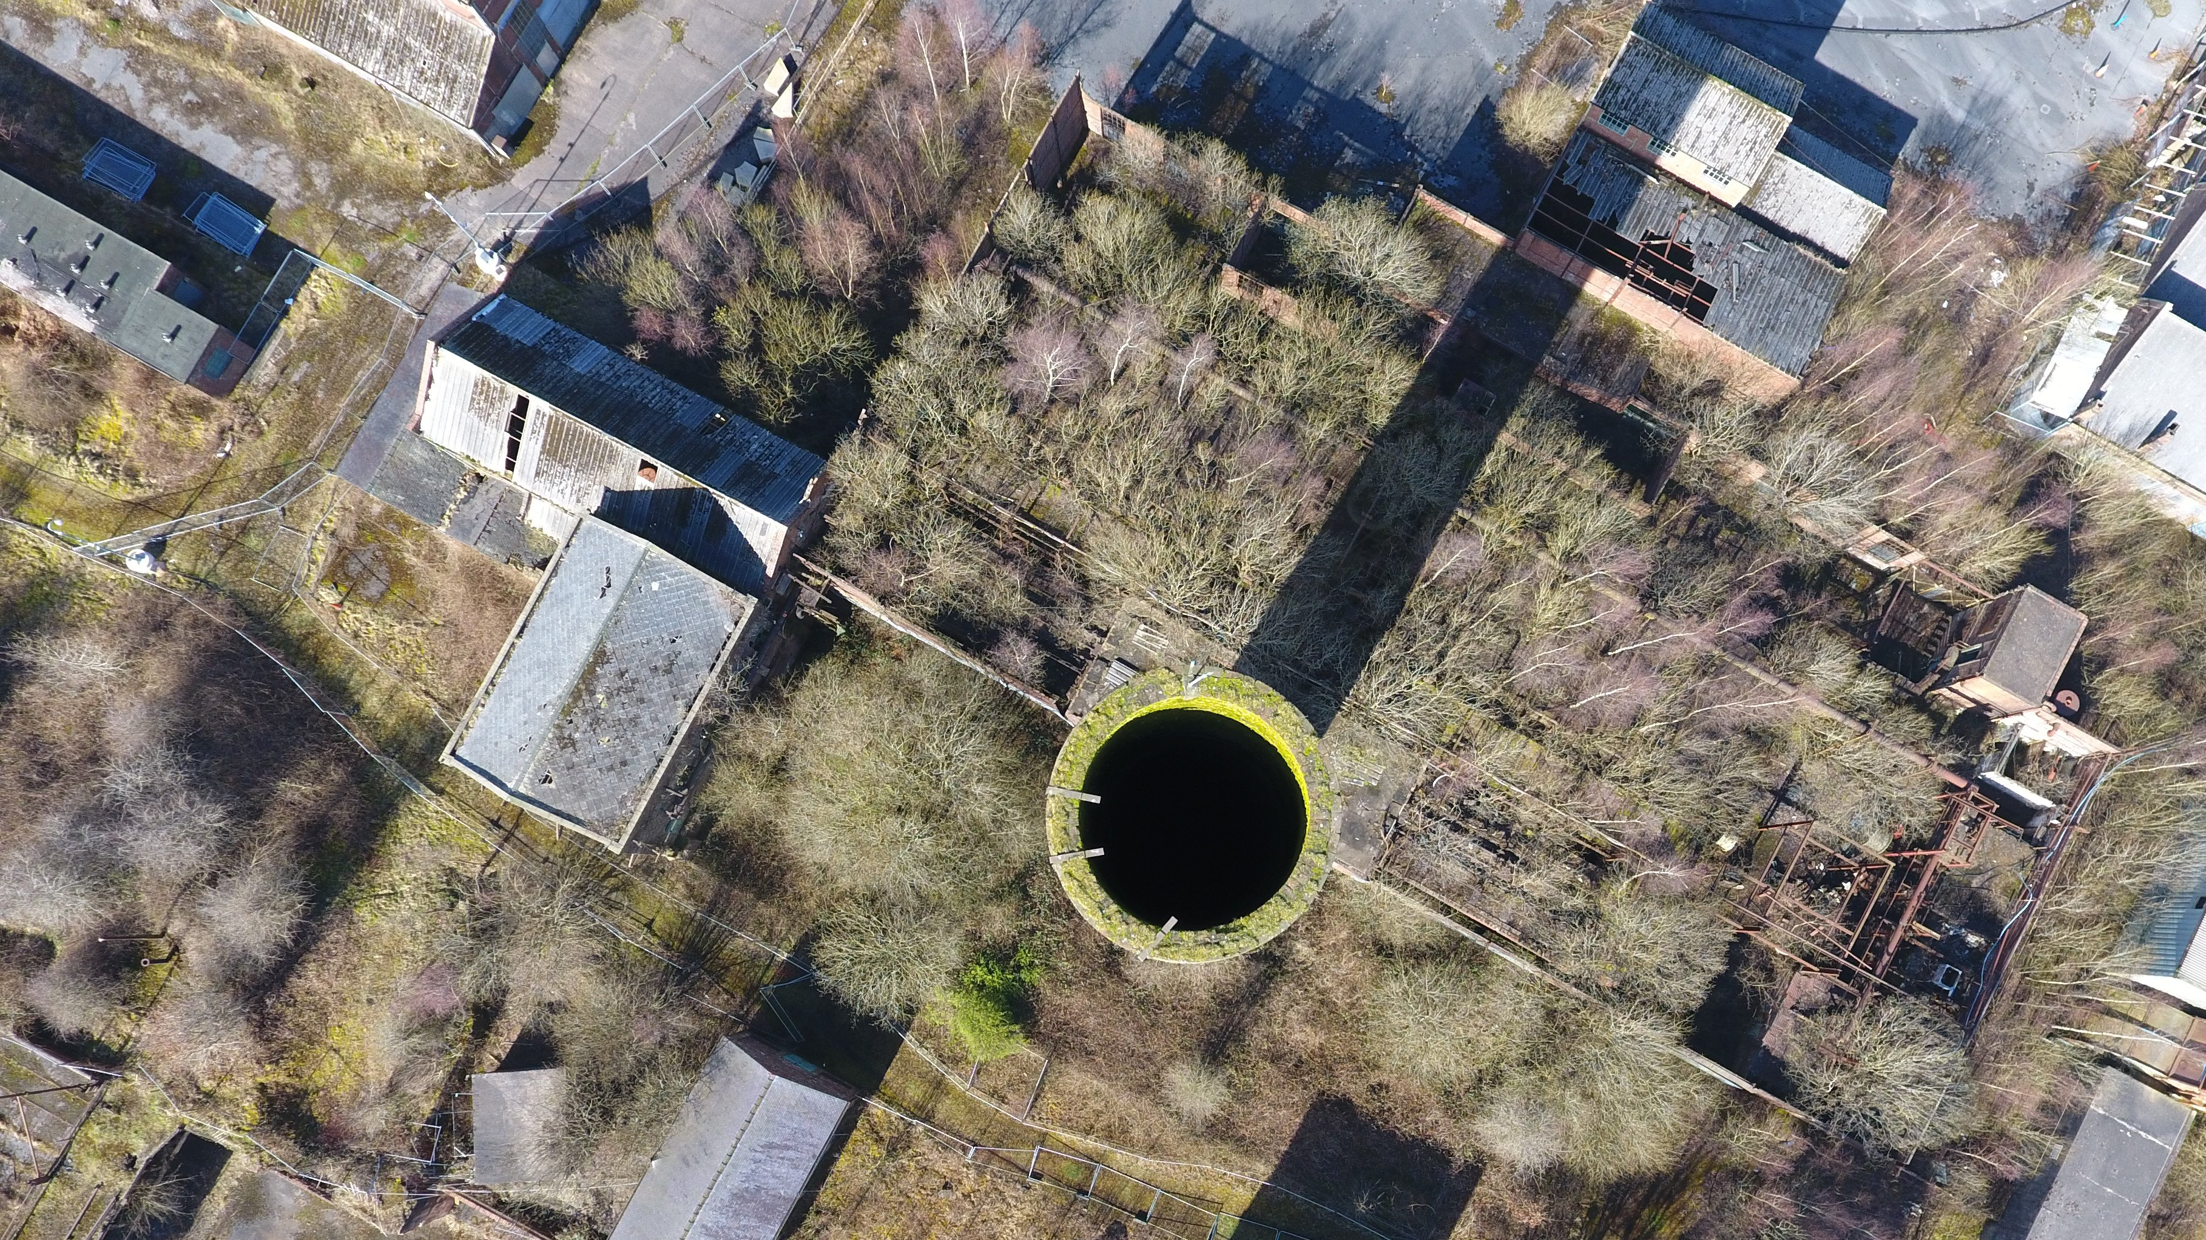
Crowd-sourced
Heritage
What is ‘Crowd-sourced Heritage’?
Techniques and Challenges.
  Information management.
  Ethics, GDPR and copyright.
Analytical Potential.
Critique.
  A Distorted History?

Slide 3
What is crowd-sourced heritage?
Use of crowd-sourced data in conservation and heritage mapping:
  Example: Crowd-sourced photogrammetry for 3D mapping.
‘Crowd-sourced’ digitisation projects (aka ‘using volunteers’)
Public-submitted (and often publicly-displayed) historical material
historical documents – in lofts, garages etc: https://www.historicalpageants.ac.uk/
personal memory documents: www.massobs.org.uk

Slide 4
Techniques and challenges.
Information Management.
Registration data input
User database
Published.
Yes
Submission data input
Submissions database
Passed to moderation.
GDPR?
Redaction/
anonymisation.
No
Yes
Matched to user
Forms ticked?
E-mail to user. Flagged for deletion.
No

Slide 5
Techniques and Challenges ethics.
www.chatterleywhitfield.online.com.
Key issues:
  Consent.
  Withdrawal from process.
  Equality and Diversity Monitoring.
  ‘Invitation’ to participate.

Slide 6
GDPR (General data protection regulation.
All projects involving the storage and use of personal data require a Data Protection Impact Assessment (DPIA).
  Key issues:
  Consent of users is already dealt with by ethical review.
  Consent of ‘third parties’ – i.e. those identifiable in submissions – is not, and unless the user can confirm consent, we cannot realistically obtain it.
  Any plan must be straightforward and understandable by you (likely) volunteer moderators.
  Original documents need to be kept for future historical research? (ie. cannot ask public to self-anonymise.)
  (Also, just a general tip for DPIAs: your lawful basis for processing is public task, not consent.)

Slide 7
GDPR (General data protection regulation)
Big Problem: 3rd parties.
  Basic principle: If you are releasing data that renders an individual identifiable without good reason, you are potentially operating illegally.
  Naming a person is making them identifiable. Identifying the job someone does might make them identifiable. Placing them in a specific time and place might make them identifiable. A rare group of attributes might make them identifiable. Their face makes them identifiable.
  Solution:
  Users can optionally confirm that they have the consent of all the individuals identified/identifiable in their submission to appear within the project.
  All images and documents (even those tagged in 1.) are moderated for non-user identifiable individuals, and redacted/names changed/images blurred as appropriate.
  Originals kept in the database, not for public dissemination for c. 100 years.

Slide 8
Copyright.
Pre-2018: Websites like https://www.historicalpageants.ac.uk/ used a Creative Commons license to allow for public sharing of crowd-sourced heritage.
ssds GDPR – Oral History Society: https://www.ohs.org.uk/advice/data-protection/
  GDPR grants the right to restrict the processing of personal data. All submissions are in some sense personal data, though with the consent of the individual for their public use. However, their consent is for restricted processing. CC confers the right to process on all, but the responsibilities for that processing would rest with the project/university.
Solution: Users grant a limited, non-exclusive copyright license to the project/university. This will need to be drawn up by your university, and is more complex than the CC license.

Slide 9
Crowd sourced heritage
Analytical potential.
Any ideas?

Slide 10
Crowd sourced heritage
Analytical potential.
Corpus Linguisitics/Text Mining/Image analysis.
  Texts are pre-digitised, and potentially linked to particular sites. It may also be possible to bring up texts within discrete categories of users for analysis.
Mapping. https://www.historicalpageants.ac.uk/pageants/ do this with a simple google map.
  Clear GIS potential for larger projects.
Combination – For example, heatmap analysis (as planned for www.chatterleywhitfield.online)
Data accessible to non-academic public-task users – especially planners, architects etc.

Slide 11
Crowd sourced heritage
A distorted history?
Obviously, this is true of all history in any case, but consider:
All personally identifiable information redacted or removed from publicly accessible material.
User likelihood of submitting controversial material in the first place?
Risks of failing to account for transgressive behaviours and creative production in the data collection?
What sort of history is this type of project likely to tell?

