Slide 1


Qualitative Diary Methods
University of Liverpool Management School
Dr Laura Radcliffe
L.Radcliffe@Liverpool.ac.uk
Twitter @LauraSue888
Dr Leighann Spencer LSpencer@liverpool.ac.uk
@SpencerLeighann

Slide 2
An Introduction to Diary Methods
Diaries – a familiar tool in daily life
Researcher Diaries- personal reflective journals maintained throughout the research process
Increasing critiques of cross-sectional research from editorial boards of leading journals (e.g. JOB, JOOP) – QDM’s offer a ‘qualitative twin’ to ESM, Quant diary studies
Qualitative Diary Methods (QDMs) - research methods that collect qualitative information over a period of time by asking participants to record entries about their every day lives.
Qualitative diaries as multi-modal with many creative possibilities
Recognised as valuable but neglected part of researcher’s toolkit

Slide 3
Why use QDMs?
Avoid (or greatly reduce) retrospection
  Capture the specifics of events/experiences/processes
    Enables us to uncover new insight into connections between phenomena (e.g. events/actions/feelings)
Enable more dynamic research – insight into how phenomena evolve over time highlighting daily changes missed by retrospective methods (within person comparison)
  Same day, different experience? (potential for daily between person comparison)
Encourages a more participant-led approach - positive impact on the power relationship between researchers and the researched
Increased participant self-analysis & reflexivity
Notes:
Two main, frequently cited, benefits:
Capturing experiences as they happen – this enables you to attain detailed descriptions of discrete moments and how events unfold, to capture fleeting moments of everyday life that (the details of which) would easily be forgotten at a later date. This can give us insights into often taken for granted daily activities.
While this benefit of reduced retrospection is also associated with quantitative diaries, qualitative diaries extend this benefit by enabling more detail in the moment and a rich understanding of participant perspectives and personal meaning making, thoughts and feelings in context.
Capturing change in experiences over time – Another benefit of qual and quant diaries (all diaries) is the capacity to capture change over time enabling within person comparison – However, while quantitative diaries can examine fluctuations in specific variables they can miss important contextual information related to these fluctuations, which can be captured using qualitative diaries. For instance, how particular environments, people or previous events/experiences may influence reactions or interactions. We can begin to understand how complex chains of events and interactions may influence thoughts/feelings/behaviour and actions.
In addition:
Monrouxe (2009) insists that a key advantage of the technique is the minimization of researcher influence over participants’ responses
Increased Participant Reflexivity - Researchers, particularly those who tend to utilise qualitative approaches, frequently keep personal reflective diaries with the aim of enabling greater critical awareness of their own impact on the research process, therefore enhancing the quality of qualitative research (e.g. Johnson and Duberley, 2003; Nadin and Cassell, 2006). In this way diaries are acknowledged as useful ways to record and analyse our personal experiences, encouraging introspection and reflection, and, in doing so, learning more about ourselves, our feelings, our thoughts and our behaviours.
They have previously been recognised as enabling deep analysis of individuals’ internal processes and practices within organisations (Symon, 2004; Plowman, 2010), and the inner workings of organisations themselves (Plowman, 2010).
For instance participants in my own studies regularly report things such as:
“it made me think more about what I actually do and analyse my motives”
“So, I had never thought of these things from that angle but after you asked me to do it, it made me think and I quite liked it actually because it gives you a different angle to think of your work and life”

Slide 4
So…Should I use QDMs?
In relation to your research questions and research aims ask yourself the following questions:
Is it important to capture an event or experience in the moment?
  Are the specific details of an event or experience important & would they be lost using more retrospective techniques (e.g. capturing the ‘mundane’, micro-practices, routines) ?
Is it important to consider temporality or how the phenomena you are studying might change over time?
  Are you exploring issues that are likely to result in change or are participants in a period of transition?
  Do you need to capture within person change? Does the phenomenon being studied and its immediate effects occur within subjects?

Slide 5
Qualitative Diaries: Challenges
Sampling and recruiting - Acquiring and maintaining participant commitment
Ensuring effective completion without the presence of the researcher (potential data loss/ lack of depth)
Returning the diaries and timely analysis
Being prepared for participant reflexivity & emotion (see Cassell, Radcliffe & Malik, 2019; Gatrell, 2009)

Slide 6
Practical considerations:
Gaining & Retaining Participant Engagement
Sampling strategies
  Personal connections/ networks (Bolger et al, 2003)
  Snowball sampling (e.g. Saunders, 2012)
  Interviews as a gateway (e.g. Radcliffe, 2013)
Length of diary study
Maintaining contact throughout
“Personal contact retains participants more so than monetary incentives or dependence upon goodwill towards science” (Bolger et al., 2003, p. 595).
  Agree how during pre-interview (Radcliffe, 2018)

Slide 7
Practical considerations:
Designing your diary study
The diary-interview method (Zimmerman & Wieder, 1977)
  Pre and post interviews are useful
Pre-Interview
  Rapport building
  Explain/discuss diary completion
  Critical indent technique can be useful (Radcliffe, 2013)
Post-Interview
  Post-analysis
  Opportunity to seek further detail/ clarification
  Space for participant reflection – how did they find keeping the diaries?

Slide 8
Practical considerations: Designing your diary study
Diary design
Unstructured or semi-structured?
Interval, signal or event contingent? (Eckenrode and Bolger, 1995)
Interval-contingent - experiences are recorded at regular, predetermined intervals of time
Signal-contingent - participants report experiences whenever they are contacted by the researcher
Event-contingent - participants report every time a pre-established event takes place
Diary instructions
Verbally & in writing
How detailed and specific?
Balancing act between avoiding ‘leading’ participants & ensuring a clear definition of the triggering event or relevant phenomena
Notes:
Interval contingent – E.g. you might ask participants to record at the end of every day or once a week depending on the overall length of the diary keeping period and what you are trying to achieve.
An event-contingent design, for example, is often useful when diaries are employed with the purpose of exploring or capturing a particular incident or event (such as work-family incidents in my own research) as providing reports at fixed times each day would not ensure that a work-family incident had occurred and could be reported.
This design requires a clear definition of the triggering event because any ambiguities as to which events fall within that definition may cause participants to omit relevant events and a decrease in the number of events reported. Participants likely to ask for examples.
You can mix event and interval contingent – e.g. record once a day or once a week (but consider what you would be asking them to record), and every time X event occurs.

Slide 9
Ethical considerations
Participant Reflexivity – “the reflexive considerations of research participants that are stimulated by their involvement in research” (Cassell, Radcliffe & Malik, 2019, p.1)
Engagement in longitudinal, participant-led, qualitative research is likely to encourage reflexive thinking - potentially accessible to the researcher
Participant reflexivity is likely to be entwined with a range of emotions, both positive & negative
Previously unknown or unrealized emotions can connect to experiences brought into consciousness through reflexivity, rather than remaining below the surface
Therefore as researchers:
  Be transparent about the potential for reflexivity in participant information sheets
  Be prepared for emotion
  Provide a safe space for participants to share their reflexive thinking
  Demonstrate empathic behaviours during the interview, for example through sensitive follow-up questioning
Notes:
Provide a safe space for participants to share their reflexive thinking - We would recommend that researchers, research supervisors and ethics committees should work to ensure that researchers are fully aware of issues surrounding participant reflexivity and that participant consent documents should also ensure that participants themselves are made explicitly aware of this, prior to providing their consent to take part.
Provide a safe space for participants to share their reflexive thinking - Hibbert and Cunliffe (2015) suggest that the learning process that accompanies reflexivity needs to move beyond the level of disturbance and doubt to create new forms of understanding.
Therefore, rather than leaving our participants without the time or space to continue the reflexivity process that our research may potentially instigate, it seems important that we provide them with the opportunity to develop that new understanding in a safe and confidential environment (Hibbert and Cunliffe, 2015).
For example, previous research on participation in qualitative research suggests that individuals often report their involvement as having therapeutic effects, providing an opportunity for them to be listened to by a person who genuinely wants to understand their stories (e.g. Miller and Boulton, 2007).

Slide 10

Task 1
Reflect on the practical and ethical considerations relevant to your research project

Slide 11

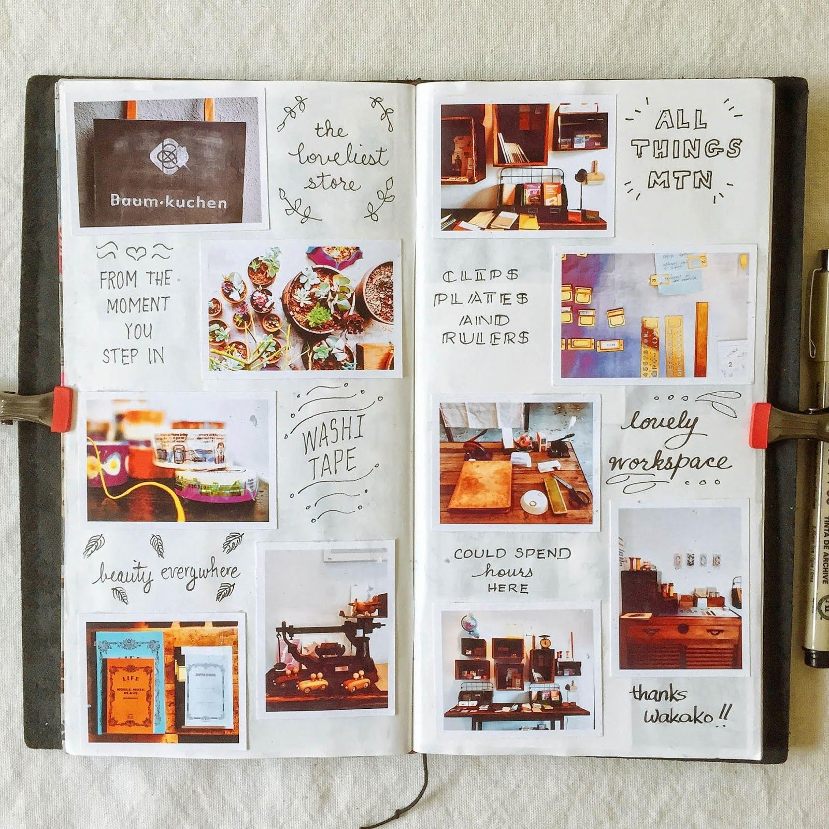


Which Diary Medium?
Notes:
Diary medium – qualitative diaries come in many forms – pen and paper, electronic (e.g. email, online notepad, blog, text messages), audio, video, photos (although this one is potentially quite different – need to consider whether you would want some text comments along with the photographs or not) Everyone has different preferences, important to consider carefully your target sample but also to consider each individual and be as flexible as possible.
We will consider each of these in more detail shortly

Slide 12
Designing pen and paper diaries
Why use pen & paper diaries?
Challenges
  More appropriate for your sample (e.g. unlikely to use technology, write as part of their daily practice)?
  Traditional approach, participant familiarity and understanding
  Avoid technical challenges
  Fewer cost implications
Returning the diaries & potential data loss
Effective recording & limited data (retrospective completion & irrelevant or minimal data)
Privacy issues
Participant convenience (i.e. carrying around a physical diary)

Slide 13
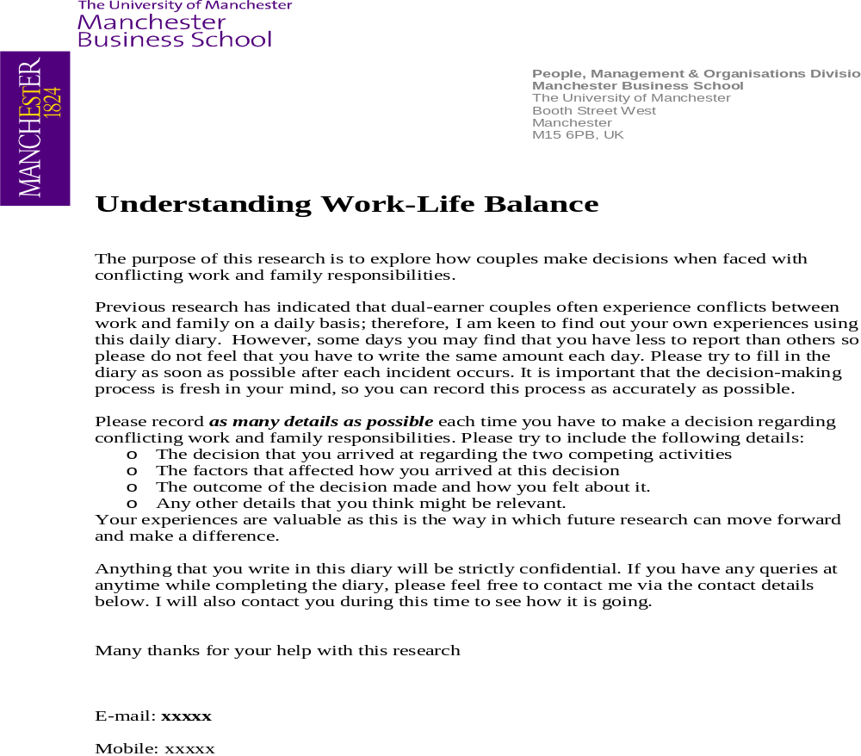
Designing pen and paper diaries: Example
Research Questions:
How do couples negotiate work and family when they experience a conflict between the two?
Why to they negotiate work and family in this way?
Duration: 4 weeks
Diary Type: Event contingent, semi-structured
Other Methods: Pre (couple) & post (individual) interviews, critical incident technique

Slide 14
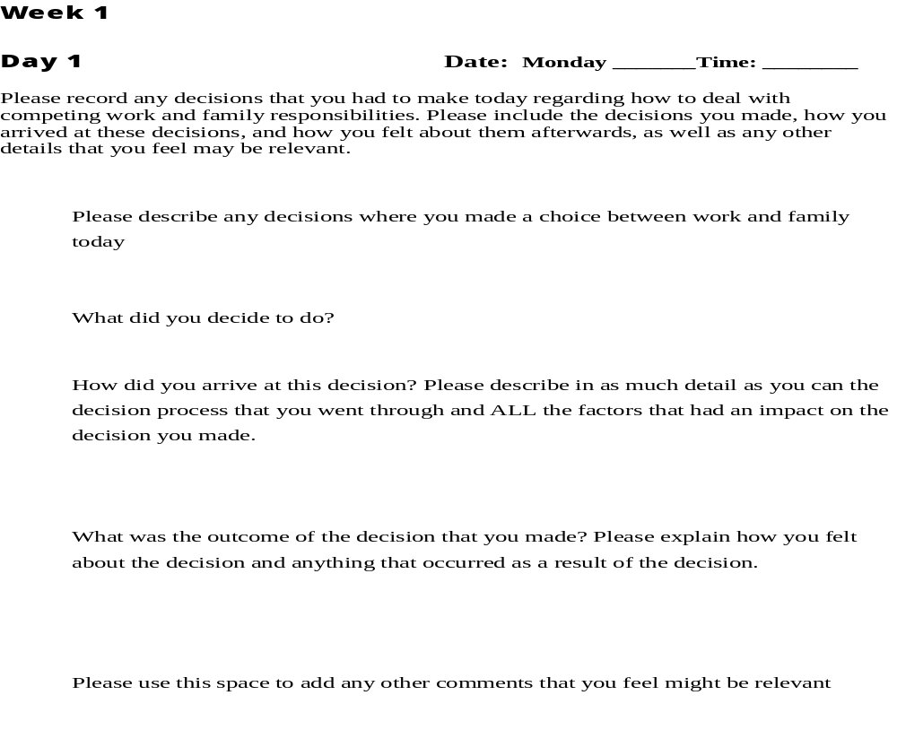
Example cont.
Why pen & paper diary?
Fewer ‘technology-based’ options readily available at the time.
Sample - Participants struggled with audio diaries during pilot.
Privacy important as 2 people keeping private diaries in one household (audio/video could have been challenging).
Radcliffe, L. S. (2013). Qualitative diaries: Uncovering the complexities of work-life decision-making. Qualitative Research in Organizations and Management: An International Journal, 8(2), 163-180 https://www.researchgate.net/publication/263458512_Qualitative_diaries_uncovering_the_complexities_of_work-life_decision-making

Slide 15
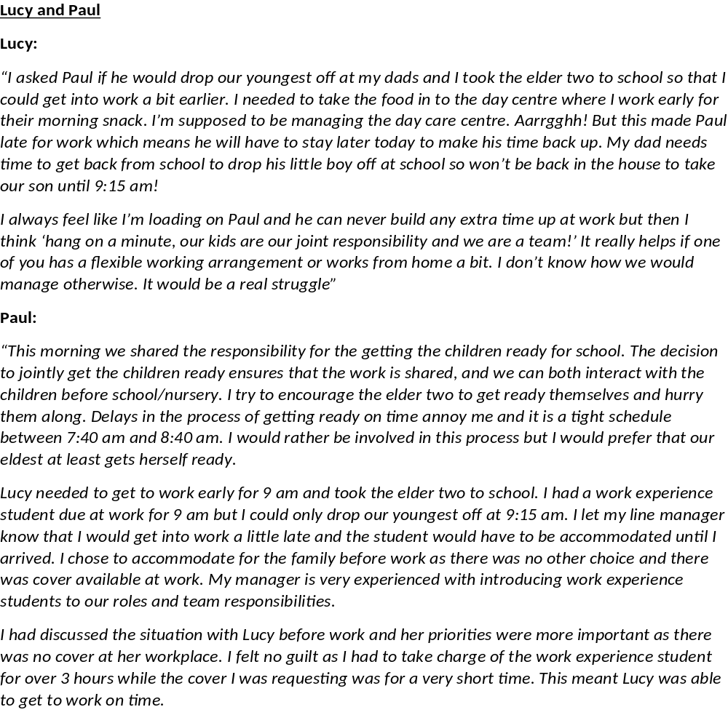
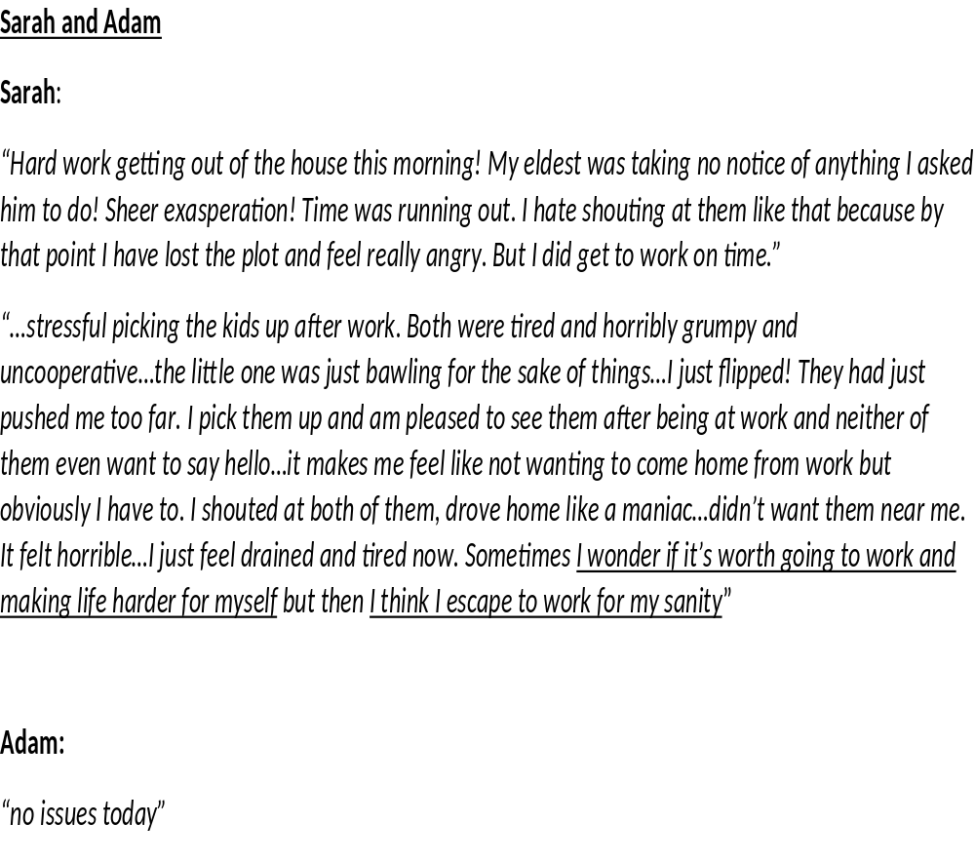

Slide 16
Audio diaries
Why use Audio Diaries?
Challenges?
If participants are more comfortable speaking than writing
Often quicker & easier for participants (e.g. Balogun, 2003)
Can lead to increased depth of responses (e.g. Markham & Couldry, 2007)
The fluidity in speech enables an immediacy of response – potentially increasing ‘naturalness’ or authenticity (omit editing/reviewing process)
Access to voice intonation/ emotion
Audio function now available on most phones
Technical challenges and data loss
Cost implications if audio recorders are required (or can phones be used?)
Not possible to attach diary information sheet or open questions as a reminder (less structured)
Privacy issues during diary completion
Some participants may not be comfortable talking and prefer to write
Notes:
Many of the publications that report the findings of audio diary research are sociological in nature or positioned within the educational field (Monrouxe, 2009; Worth, 2009).
Balogun et al (2003) – JMS - It is often easier to dictate comments immediately after a relevant event occurs, between other responsibilities, when something is remembered, or when an insight occurs. The audio format is likely to encourage more openness, directness and self-expression, and perhaps allow for more emotive observations than written records.
Diaries spoken into voice recorders tended to be less structured but often saw the diarist reflect on his or her relation to a particular issue in great depth’ (Markham & Couldry, 2007, p. 684).

Slide 17
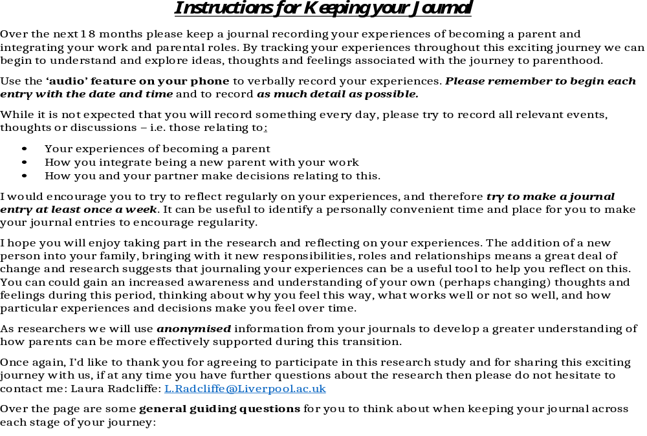
Designing Audio Diaries: Example
Research Questions:
How are work-family experiences & challenges different for men and women during the transition to parenthood?
How does this influence work-care decision-making processes throughout this period?
Duration: 18 months
Diary Design: A mix of event & interval contingent, unstructured
Other Methods: 3 (individual) interviews (pregnancy, parental leave, return to work)

Slide 18

Example cont.
Why audio diaries?
Length of diary study duration – participant ease & concerns in terms of data loss
Need to view the diaries on an ongoing bases for analysis & interview discussion points
Sample - Participants were given the option to type or audio record (some used both interchangeably)
Crozier, S. E., & Cassell, C. M. (2016). Methodological considerations in the use of audio diaries in work psychology: Adding to the qualitative toolkit. Journal of occupational and organizational psychology, 89(2), 396-419. https://onlinelibrary.wiley.com/doi/pdf/10.1111/joop.12132

Slide 19
Video diaries
Why use Video Diaries?
Challenges
When the visual is important (emotion, facial expressions, body language)
Multi-modal approach – our experiences are more than words textual data represent only a partial subset of embodied life (e.g. Strati, 2007)
When the environment/ location/ physical journey is important – ‘audio-visual glimpses into the wider world of participants’ (Zundel et al, 2018)
When we want to capture what people are physically doing in their daily lives
Participant as researcher
Participant discomfort/ reluctance
Anonymity
Privacy issues during data collection
Recording devices, technical challenges & data loss
Storing & sharing the data
How to analyse video data
Notes:
Multi-modal approach - Participants are experiencing and enacting their world through all of their senses in ways that exceed that which can be linguistically recorded (KnorrCetina, 1997; Strati, 2007).
When the environment/ location/ physical journey is important - Zundel et al (2018) Video diaries can provide both: more and richer data. When studying bodily expressions, video diaries can produce close-up recordings of sometimes intense moments of joy or despair, confessions and worries, as well as conflicts and alliances.
Offer audio-visual glimpses into the wider work-world of the participants.
Episodes/ processes unfolding in different contexts

Slide 20
Video Diaries: Example
Participants recording their environment:
Whiting, R., Symon, G., Roby, H., & Chamakiotis, P. (2018). Who’s behind the lens? A reflexive analysis of roles in participatory video research. Organizational Research Methods, 21(2), 316-340. http://www.scc.lancs.ac.uk/research/projects/DBS/research-studies/video-diaries-interviews/
Research Question: How do people switch between their work and private lives?
Duration: 1 week
Diary Design: Event-contingent, unstructured, capturing what they see in front of them/ outward facing
Other Methods: Pre-diary briefing, post-diary briefing & post-diary analysis interviews
Instructions/ Ethical guidelines: “We outlined ethical guidance of ‘‘what not to film’’ in the briefing presentation. This included: anything confidential, sensitive, or highly personal; children (unless participant’s own and both parents agreed); other people unless in a public place where they might reasonably expect to be observed or were people they knew who consented to be filmed; in shopping centers or areas with high-security status; and while driving or cycling.”
Analysis - currently an overview thematic analysis has been undertaken of the combined video/interview data set with more detailed thematic and discourse analysis around a number of initial themes
Notes:
Zundel et al (2018) – study of distributed sense-making processes in relation to strategic decisions within an entrepreneurial engineering service firm at a time of change
Managers from the firm were invited to upload a video diary at least weekly using a private ‘YouTube’ channel where the researchers could see entries from all of the diarists but each participant could only access their own recordings
Instructions: “comment on any developments arising in the life of the organization since your last recording that you feel to be significant”
Transcribed and conducted thematic analysis on diary material monthly – acted as a guide for the next phase. Each subsequent email instruction combined both the general prompt (“comment on any developments) and a more specific prompt based on the previous analysis
Duration: Approx 3 months
Analysis: Alongside thematic coding made note of audio and visual cues such as body language, facial expression, etc

Slide 21
photo-elicitation diaries
Why use Photo Diaries?
Challenges
When the visual is important (e.g. objects, environment, surroundings)
Enables different insights into a given phenomenon - facilitates the exploration of the everyday, taken for granted
Participant ease & enjoyment
Participant as researcher
Issues of anonymity & privacy – a key challenge to be aware of throughout
Whether or not to ask for written discussion at the time of taking the photograph – may lead to more practical challenges/ reduce ease
How to analyse photographic data
Notes:
Cassell, C., Malik, F., & Radcliffe, L. S. (2016). Using photo-elicitation to understand experiences of work–life balance. In Handbook of Qualitative Research Methods on Human Resource Management. Edward Elgar Publishing.
Creating their own narratives
research participants taking their own photographs of a subject as guided by the researcher/s

Slide 22

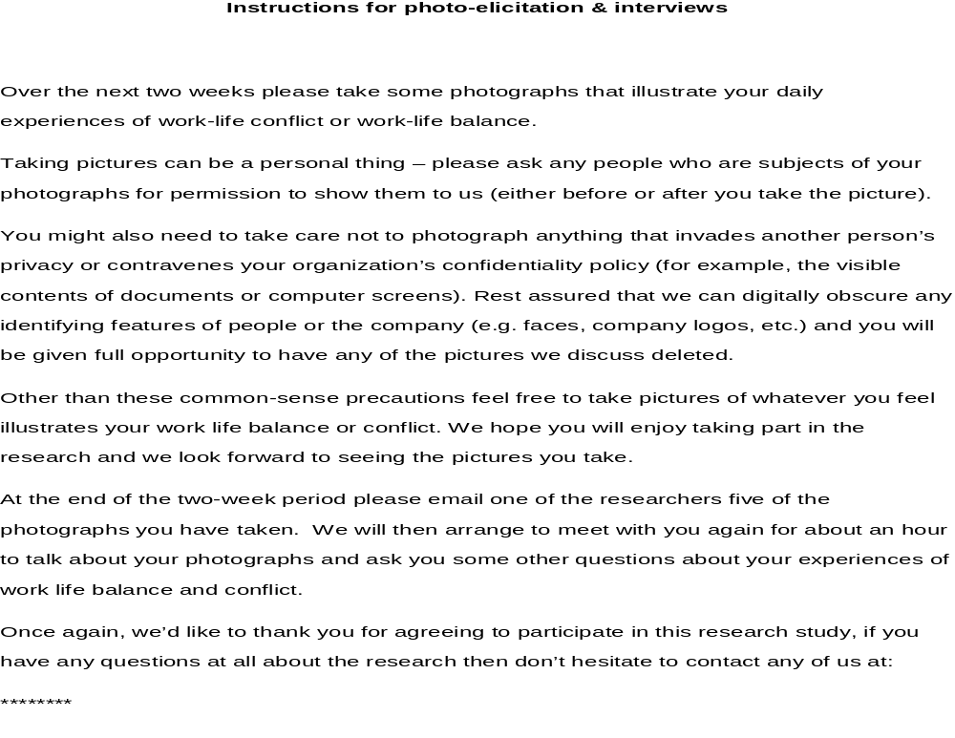
Research Question:
How do people conceptualise work-life balance and work-life conflict in their daily lives?
Duration: 2 weeks
Diary Design: Event or ‘object’ contingent, unstructured
Other Methods: Follow-up interviews
We drew upon Vince and Warren’s (2012) notion of responsible photography to underpin the instructions for the research participants
Notes:
We drew upon Vince and Warren’s (2012) notion of responsible photography to underpin the instructions for the research participants as we were particularly keen to observe ethical practice in managing this process.
Vince, R. and Warren, S. (2012). Participatory visual methods. In G. Symon and C.M. Cassell (Eds.) Qualitative Organizational Research: core methods and current challenges. London: Sage.

Slide 23
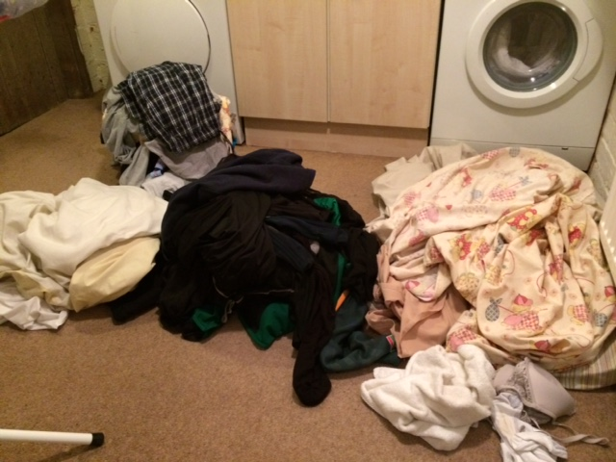
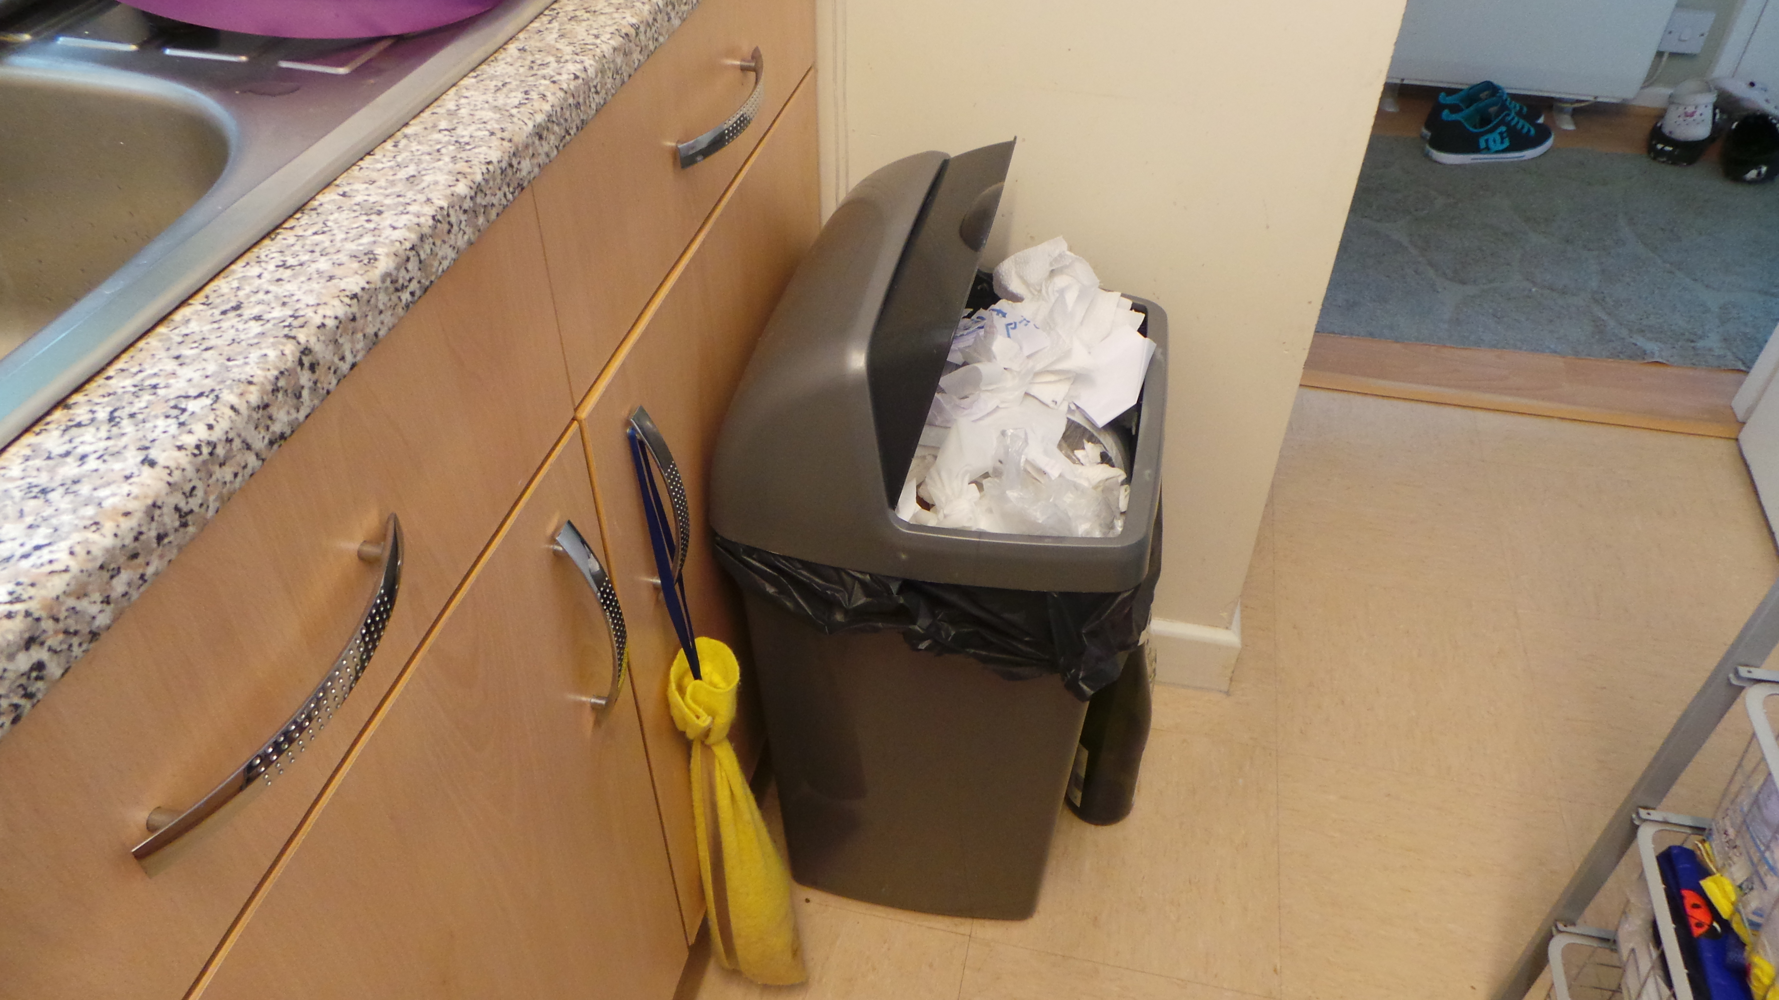
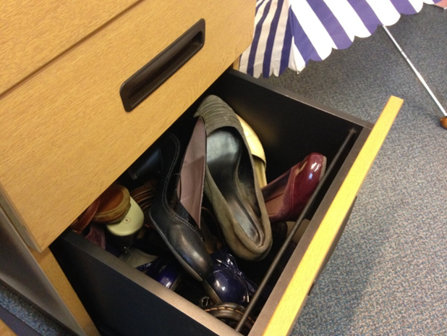
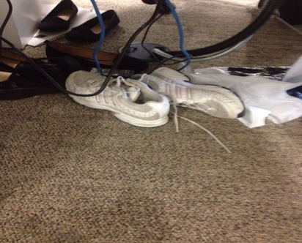
Example cont.
Why Photo Diaries?
Desire to capture daily lived experiences from participants perspectives – ‘Episodic Snapshots’
Lived experience is multi-modal & visual cues can be important - to gain a deeper understanding of the holistic nature of the work-life relationship
Use of photos as a ‘conversational technology’ & strong participant-led approach
Ease of use for participants to enable us to access a diverse sample
Photos can now be easily taken on most smart phones
Cassell, C., Malik, F., & Radcliffe, L. S. (2016). Using photo-elicitation to understand experiences of work–life balance. In Handbook of Qualitative Research Methods on Human Resource Management. Edward Elgar Publishing.
Notes:
WLB & WLC has been extensively studies but now a great deal of critique about the terminology and questions around what these terms actually mean for diverse individuals in daily practice. We wanted to bring a fresh perspective. What does it mean to feel WLB or what represents WLB in people’s daily lives.
There has been a concern that the term work-life balance is more appropriately considered a “misnomer” due to its limitations in capturing the multi-faceted and multi-dimensional nature of the work and family domains (Guest, 2002:262). Other critiques have focused upon the inappropriateness of the metaphor of balance (Cohen, Duberley and Musson, 2009), and the normative constructions of both the terms ‘work’ and ‘life’ (Özbiglin et al, 2011). Moreover, it has been recognised that most research has focused upon a stereotypical view of the family as forming the ‘life’ part of ‘work-life’, neglecting the diversity of both individual and collective experience in this area.
This study seeks to elicit the diversity of different experiences of work-life balance from different and under-researched groups (Gatrell, 2005; Gatrell et al, 2013; Voyandoff, 2005). Here our aim was through a longitudinal episodic approach to gain a deeper understanding of the holistic nature of the work-life relationship. We chose photo-elicitation rather than video because we were keen to use episodic snapshots of the participant’s experiences of work-life balance. With video the participant produces videos which are then edited by the researcher. In this case we wanted participants to also act as editors, to use the photographs to illustrate their edited snapshot versions of their work-life balance.

Slide 24
multi-modal qualitative ‘App’ diaries

Slide 25
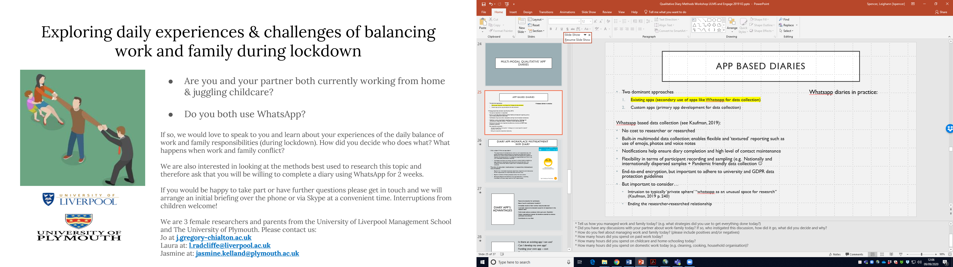
App based diaries
Two dominant approaches
  Existing apps (secondary use of apps like Whatsapp for data collection)
  Custom apps (primary app development for data collection)
WhatsApp based data collection (see Kaufman, 2019):
No cost to researcher or researched
Built-in multimodal data collection; enables flexible and ‘textured’ reporting such as use of emojis, photos and voice notes
Notifications help ensure diary completion and high level of contact maintenance
Flexibility in terms of participant recording and sampling (e.g. Nationally and internationally dispersed samples + Pandemic friendly data collection ☺ )
End-to-end encryption, but important to adhere to university and GDPR data protection guidelines
But important to consider…
  Intrusion to typically ‘private sphere’ “whatsApp as an unusual space for research” (Kaufman, 2019 p. 240)
  Ending the researcher-researched relationship
WhatsApp diaries in practice:
Notes:
Benefits:
Easy multi-modality
A way to be there without being there (useful for COVID situation)…an ethnography without being in the field, and where you can also seek to capture participant’s internal processes – e.g. thoughts, feelings, decision-making
Challenges:
Can be invasive…think carefully about frequently and time frames and about how often/how many follow-up questions you might ask
Takes up researchers own personal space and time – personal phone? Evening work?
Leads to stronger relationships with participants….(follow-up interviews useful as an end point)

Slide 26
Diary App: Workplace mistreatment
“WIM diary”
Why a diary? Why an app diary?
  The experience of mistreatment at work is a well researched area, with studies consistently demonstrating its prevalent and destructive nature (Branch et al., 2013; Nielsen & Einarsen, 2012). Yet despite this plethora of research, the phenomena as it is subjectively experienced over time is not well understood. (theoretical rationale)
  Mistreated individuals are strongly advised (i.e. ACAS, CIPD, UNISON) to keep records of interactions and events so as to provide them with ‘evidence’ should they seek to report their mistreatment (practical rationale)
The aims of using diary methodology in researching mistreatment were threefold:
  Explore how mistreated employees experience, respond to and make sense of their experiences on a day-to-day basis and over time.
  Explore variations of these processes across men and women.
  (Emergent) Explore the feasibility of an app based diary in assisting mistreated individuals keep record of their experience(s)

Slide 27
Diary App’s:
Advantages
Password protection for participants
Ease of use for participants (hopefully!)
Immediate receipt of diary entries (reducing data loss)
Automatic (password protected) access for all researchers in the research team
Multi-modal options contained within each entry (flexibility)
Media/ organisational interest (& therefore potential to enhance participant recruitment)
Contribution to your field

Slide 28
Diary App’s:
Challenges
Is there an existing app I can use?
Can I develop my own app?
Funding your own app – cost
Developing the app…
  Finding the right person for the job
  Communicating your ideas
  Pilot testing the app
  Development across different platforms
  Maintaining the app
Data privacy concerns – GDPR
Drawing up a contract (IP)
Spencer, L. and Radcliffe, L. (2018) Creating your own ‘App’ diary project: A checklist and information sheet. Research Methods Festival, National Centre for Research Methods

Slide 29
Task 2
Brainstorm potential design choices in for your own diary study diary:
Why a diary?
Event/ interval-contingent?
Sample considerations?
Medium, what and why?

Slide 30
Analysing Qualitative Diary Data

Slide 31
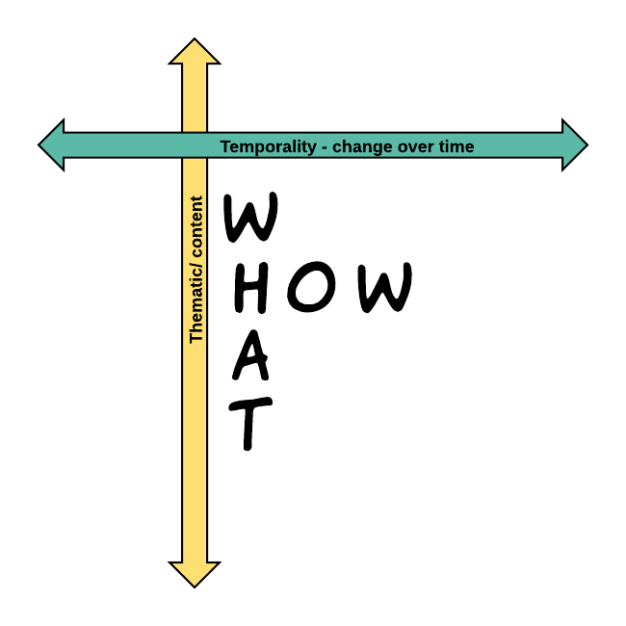
Analysing Qualitative Diary Data:
Some challenges
Diary data is voluminous and complex
Currently a lack of detailed information on how to analyse qualitative diary data – no diary specific analysis approach
Available qualitative analysis approaches have limitations when analysing diary data e.g. Using themes/thematic analysis constrains our ability to follow cases or even themes over time in a systematic way
Ask yourself, why did you use qualitative diaries in the first place? (see the rationale in published studies)
  To capture events/experience/thoughts/emotions in the moment?
  To capture change over time?
  Both? - Requires an approach able to capture the process of change over time without losing insights about experiences/thoughts/feelings at particular points in time.

Slide 32
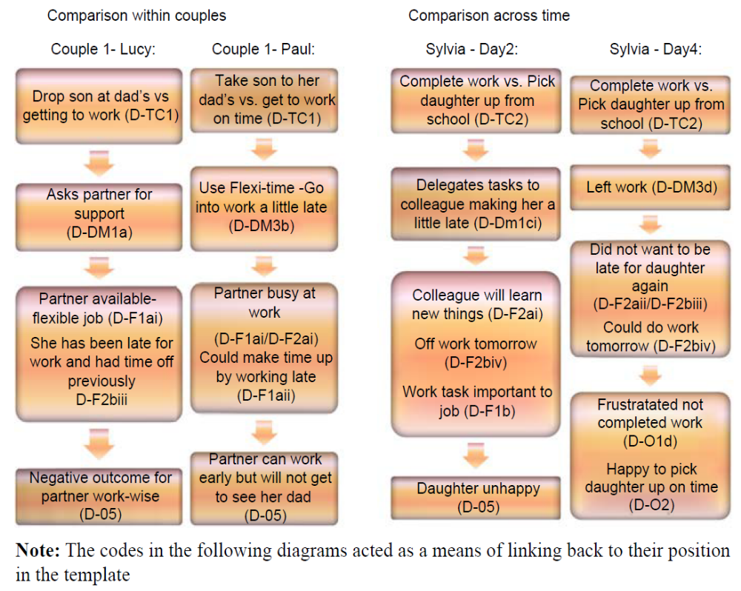
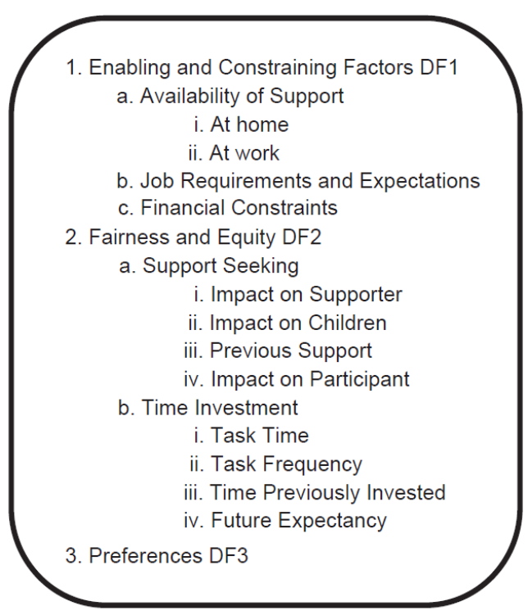
A Thematic & Diagrammatical example (Radcliffe, 2013; 2014)
Step 3: Comparative analysis – within and between participants
Analysing diaries to capture experiences in the moment and exploring how different elements connect to one another?
Step 1: Thematic Analysis
Step 2:
Create Activity/ Event Diagrams
Research Questions:
How do couples resolve daily work-family conflicts?
Why are conflicts resolved in this way?
Notes:
Step 1 – Thematic Analysis (diaries and interviews) with RQs in mind – I used Nigel King’s template analysis as this is a flexible technique that you can easily use across mediums
Step 2 – determined by why you have opted to use qual diaries (i.e. to capture the specifics of events as they happen, to capture change over time or both) In this example, it was to capture the specifics of events as they happen – Therefore, in this case, step 2 is to draw event or activity diagrams (which include themes from your thematic template) but here you are showing the relationship between these themes and maintaining the detail of each incident (which was the purpose of using the diary method in this case) – This allows you to explore what led to what and why – so, for example, you can see the factors that tend to lead to particular decisions, or you can see the kinds of decisions that lead to particular outcomes [N.B. If change over time was a key reason for using qual diaries/ is a key part of your RQs – here you need to produce a temporal representation of your data using a timeline approach]
Step 3 – Different kinds of comparative analysis depending on your RQs and/or what seems most interesting in your data:
So within person comparison – how the same person handles different activities and events – when this is similar or different and why?
Across person comparison of the same event – have different people responded to the same event in a similar or different way? Why?
This makes best use of the diary for exploring the specifics of events as they happen. These diagrams help with analysis of the specifics and the relationships between the specifics – capturing these in a detailed way in the moment.
How do couples manage work-family conflicts and why? So this kind of analysis helps us to answer this question
But if the question was asking how daily work-family conflict is experienced over time we would need a different kind of analysis…see next slide

Slide 33
Conclusions:
Nothing worth having was achieved without effort…
All qualitative diary studies are challenging and require perseverance!
We argue that the potential rewards make perseverance worthwhile
Qualitative diaries enable in-depth exploration of the everyday from the perspective of participants, reducing retrospection and permitting within person analysis over time
Qualitative diary methods cover a diverse range of methods - explore and make use of this diversity!
As always, choice of (qualitative diary) method, including analytical processes, should be led by your research questions and the aims of your study

Slide 34

Q&A and discussion

